Slide 1
Chapter 4:-
Number Theory
Compiled By:- Akash Mehta
GIT.
Notes:
Akash Mehta

Slide 2
Outline
Prime And Relative Prime Numbers
Modular Arithmetic,
Euler’s Theorem
Euclid’s Algorithm
Discrete Logarithm Tics
Akash Mehta

Slide 3
Prime Numbers
An integer p > 1 is a prime number if and only if its only divisors are ± 1 and ±p. Prime numbers play a critical role in number theory and in the techniques like RSA, Deffie-Hellman key exchange.
Akash Mehta

Slide 4

Contd…
Any integer a > 1 can be factored in a unique way as
where p1 < p₂ < ... < p_{t} are prime numbers and where each is a positive integer. This is known as the fundamental theorem of arithmetic.
Akash Mehta

Slide 5
Contd...
If a and b are two prime numbers then this condition will always satisfy:
  gcd(a, b) = 1
Relatively Prime
  Two integers are relatively prime if their only common positive integer factor is 1.
  gcd(a, b) =1 ex: 8 and 15
Akash Mehta

Slide 6
Divisibility & The Division Algorithm
Divisibility
  We say that a nonzero b divides a → b|a
  If b|a, we say that b is a divisor of a.
The positive divisors of 24 are 1,2,3,4,6,8,12, and 24.
13|182 ; -5|30; 17|289
Akash Mehta

Slide 7
Properties of Divisibility integers
If a|1, then a= ±1
If a|b and b|c, then a|c
  Ex: 11|66 and 66|198= 11|198
Any b ≠ 0 then, b|a
Akash Mehta

Slide 8
Division Algorithm
Given any positive integer n and any nonnegative integer a, if we divide a by n, we get an integer quotient q and an integer remainder r that obey the following relationship:
a = qn + r
Akash Mehta

Slide 9
Modular Arithmetic
Modular arithmetic properties:
[(a mod n) + (b mod n)] mod n = (a+b) mod n
[(a mod n) - (b mod n)] mod n = (a-b) mod n
[(a mod n) × (b mod n)] mod n = (a×b) mod n
11 mod 8 = 3; 15 mod 8 = 7
[(11 mod 8) + (15 mod 8)] mod 8 = 10 mod 8 = 2
(11 + 15) mod 8 = 26 mod 8 = 2
[(11 mod 8) - (15 mod 8)] mod 8 = - 4 mod 8 = - 4
(11 -15) mod 8 = - 4 mod 8 = - 4
[(11 mod 8) x (15 mod 8)] mod 8 = 21 mod 8 = 5
(11 x 15) mod 8 = 165 mod 8 = 5
Akash Mehta

Slide 10
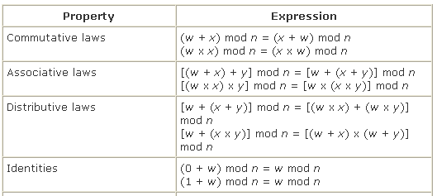
Laws for Modular Arithmetic
Akash Mehta

Slide 11
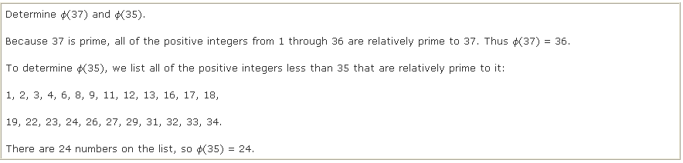
Euler's Totient Function
Before presenting Euler's theorem, we need to introduce an important quantity in number theory, referred to as Euler's totient function and written Ø(n), defined as the number of positive integers less than n and relatively prime to n. By convention, Ø(1) = 1.
Akash Mehta

Slide 12
Euler's Theorem
Euler’s play important roles in public-key cryptography .
Euler’s Theorem:
Euler’s theorem states that for every a and n that are relatively prime: ( Congruences )
Proof: Equation is true if n is prime, because in that case Ø(n) = (n -1) and Fermat's theorem holds. However, it also holds for any integer n. Recall that f(n) is the number of positive integers less than n that are relatively prime to n. Consider the set of such integers, labeled as follows:
R {x₁, x₂,..., x_{Ø(n)}}
Akash Mehta

Slide 13
Contd...
That is, each element x_{i} of R is a unique positive integer less than n with gcd(x_{i}, n) = 1. Now multiply each element by a, modulo n:
  S = {(ax₁ mod n), (ax₂ mod n),..., (ax_{Ø(n)} mod n)}
If ax_{i} mod n = x_{i}
Akash Mehta

Slide 14
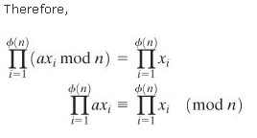
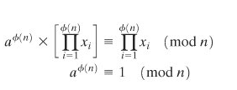
Contd…
Akash Mehta

Slide 15
a=3; n=10; Ø(10) =4 a^{Ø(n)} =3⁴ =81= 1(mod 10) = 1 (mod n)
a=2; n=11; Ø(11)=10 a^{Ø(n)} =2¹⁰=1024=1(mod 11) = 1(mod n)
Akash Mehta

Slide 16
The Euclid’s Algorithm
One of the basic techniques of number theory is the Euclidean algorithm, which is a simple procedure for determining the greatest common divisor of two positive integers.
Akash Mehta

Slide 17
Contd…
We will use the notation gcd(a, b) to mean the greatest common divisor of a and b. The positive integer c is said to be the greatest common divisor of a and b if
  c is a divisor of a and of b;
  any divisor of a and b is a divisor of c.
An equivalent definition is the following:
gcd(a, b) = max[k, such that k|a and k|b]
gcd(60, 24) = gcd(60, 24) = 12
Akash Mehta

Slide 18
Finding the Greatest Common Divisor
Euclid’s Theorem:
For any nonnegative integer a and any positive integer b,
Proof:
The algorithm assumes a > b > 0. It is acceptable to restrict the algorithm to positive integers because gcd(a, b) = gcd(|a|, |b|).
Akash Mehta

Slide 19
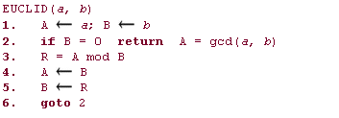
Euclid’s Algorithm
Akash Mehta

Slide 20
Discrete Logarithm Tics
Discrete logarithms are fundamental to a number of public-key algorithms, including Diffie-Hellman key exchange and the digital signature algorithm (DSA).
Logarithms for Modular Arithmetic
Calculation of Discrete Logarithms
Akash Mehta

Slide 21
Logarithms for Modular Arithmetic
The properties of logarithms include the following:
  log_{x}(1) = 0
  log_{x}(x) = 1
Akash Mehta

Slide 22
Contd…
This exponent i is referred to as the discrete logarithm of the number b for the base a (mod p). We denote this value as dlog_{a.p}(b).
Akash Mehta

Slide 23
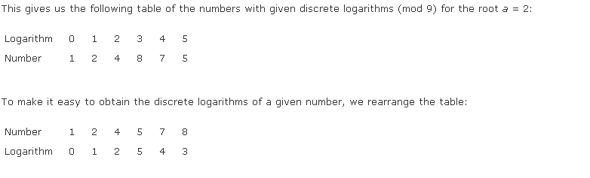
Example
Akash Mehta

Slide 24
Calculation of Discrete Logarithms
Consider the equation
y = g^{x} mod p
Given g, x, and p, it is a straightforward matter to calculate y. At the worst, we must perform x repeated multiplications, and algorithms exist for achieving greater efficiency.
However, given y, g, and p, it is, in general, very difficult to calculate x (take the discrete logarithm).
Time complexity O(e^{(ln p)1/3(ln ln p)2/3})
Akash Mehta
Notes:
Akash Mehta

